Slide 1
2016 PARCC Test Administrator Training

Slide 2
Goals for today:
Familiarize test administrators with their TAM
Familiarize test administrators with Pearson Access Next
Teachers read and sign Security Agreement
Your copy is Appendix B
Answer any questions that teachers have
Success will be if you leave today feeling 90% (or more) comfortable and ready to administer the PARCC!

Slide 3
Hooray!
One testing window instead of two!
No seal codes (teacher unlocks the test instead- I’ll show you how)
Students will not write names on scratch paper
No other major changes from last year

Slide 4
Your TAM
Test Administrator Manual
Tabs: Before, During, After
Your “Script” is tabbed by grade/subject/unit in the During section (beginning p 22)
You must have your TAM with you to administer the PARCC

Slide 5
Security/Administrative Policies
Please turn to page 3 of your TAM
Secure materials
Review this manual before administering
Follow the script
Cover displays before you leave for break
Full attention on testing
No assistance/cheating

Slide 6
Irregularities/Breaches p. 5
Cell phones in the testing room (students must leave in lockers; teachers’ should remain out of sight while testing)
Before testing, your script will prompt you to ask students to raise their hand if they have electronics- no penalty. If time permits, have them return it to locker. If there’s no time, student must turn off device (power it off!) and give to teacher
Engaging in activities (e.g., grading papers, reading) that prevent proper supervision of students
Reproducing any part of the test
Report any irregularities to me right away!

Slide 7
Testing Environment p 6
Students may read recreational materials (not related to the test) when finished
No electronics (or using Chromebooks for anything besides testing) when finished

Slide 8
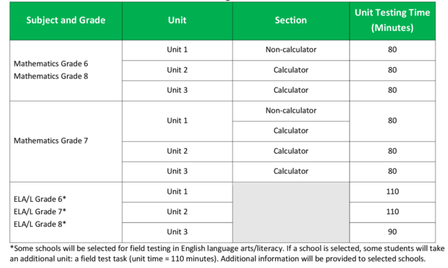
Testing Time p 8-9
*We are a field test school taking 4 total units of ELA/L

Slide 9
Timing p 8
Although we are permitted to end a session early if all students are finished testing, our DMS plan is to allow the full time to all students testing.

Slide 10
Before Testing p 10
Please be sure that the testing room is prepared- no instructional displays that could assist during test
Familiarize yourself with the TAM and procedures
Hang the Do Not Disturb sign that will be included in your folder on the day of testing
Read and sign Security Agreement
Prepare a space to write the timing box on the board or other visible place (p 12)

Slide 11
Desks p 11
Desks in rows prior to testing
Discourage cheating by circulating

Slide 12
During Testing p 13
Log yourself into Pearson Access Next and select your session
Click start then unlock the session (we’ll learn this)
Distribute materials and follow the script
Keep time
Monitor test security
Lock the session by sliding the circle from unlock to lock when all students are finished
Collect materials for return

Slide 13
Clarifying, Misconduct, and Breaks
Clarify general directions (p 18)
Call office is a student needs to be dismissed from the testing room (p 19)
Breaks (p 20)
Students log out, TA locks test, and materials are returned – follow script
Call office, we’ll come to you to collect materials
Scratch paper with no writing may be reused

Slide 14
Quick Video for Test Administrators
First Video (begins on p 13 of TAM)
https://www.youtube.com/watch?v=na_99v00bDs
Second Video:
https://www.youtube.com/watch?v=eR1vkkWd2x8
Third Video:
https://www.youtube.com/watch?v=u9DFcc1wEHI
Notes:
Move this up?

Slide 15
Day of Testing: Tech Steps Summary
Sign out the student testing tickets
Log on to nj.pearsonaccessnext.com on your computer
Check in the upper right corner of the screen that you are 2016 Spring PARCC
Click Testing -> Students In Sessions
Type in your session in “Session List” (see student testing ticket for exact session name)
Your session will appear- click it

Slide 16
Day of Testing (cont.)
Click the green start button and unlock the correct section (slide button over to unlock)
Follow script:
Hand out your students’ testing tickets
Have students test audio then login
Lock the test for any absent student by clicking the down arrow in the box that corresponds with their name
Students may read recreational book when finished testing

Slide 17
If student exits test:
If there is an interruption with testing (computer issue, student uses bathroom), student test will need to be resumed:
On teacher computer, scroll down to student’s name
Student will show a red exited box
Click the down arrow on this red box which will give options- click resume (or resume upload)
Student should then log back in and resume

Slide 18
TA Script- Let’s Flip Through!
Begins on p 22 of TAM
Check for your grade level
Highlight and flag as you need but stick to the script!
We will follow Option C- books are allowable

Slide 19
Chromebooks andTraining Site Demo
Demonstrate what students will see on Chromebook
https://trng.pearsonaccessnext.com/customer/index.action
Resources will be available for you to review and tutorials are available on www.parcc.pearson.com/tutorial

